Slide 1
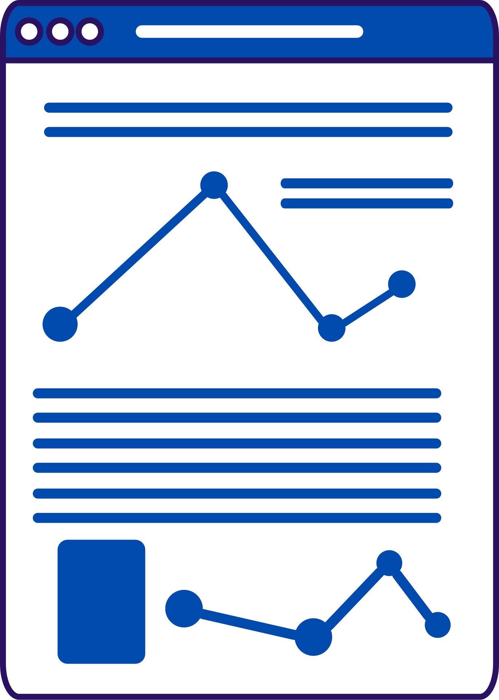
Important supervised ML models

Slide 2


List Of Contents
Linear Regression model
Train the model and test accuracy
Logistic Regression
Support Vector Machines (svm)
MLE
4
7. Dicussion,Conclusion and Refrences

Slide 3
Linear Regression
It is a type of supervised machine learning algorithm that computes the linear relationship between the dependent variable and one or more independent features by fitting a linear equation to observed data.
Finding the line of best fit
7. Dicussion,Conclusion and Refrences

Slide 4
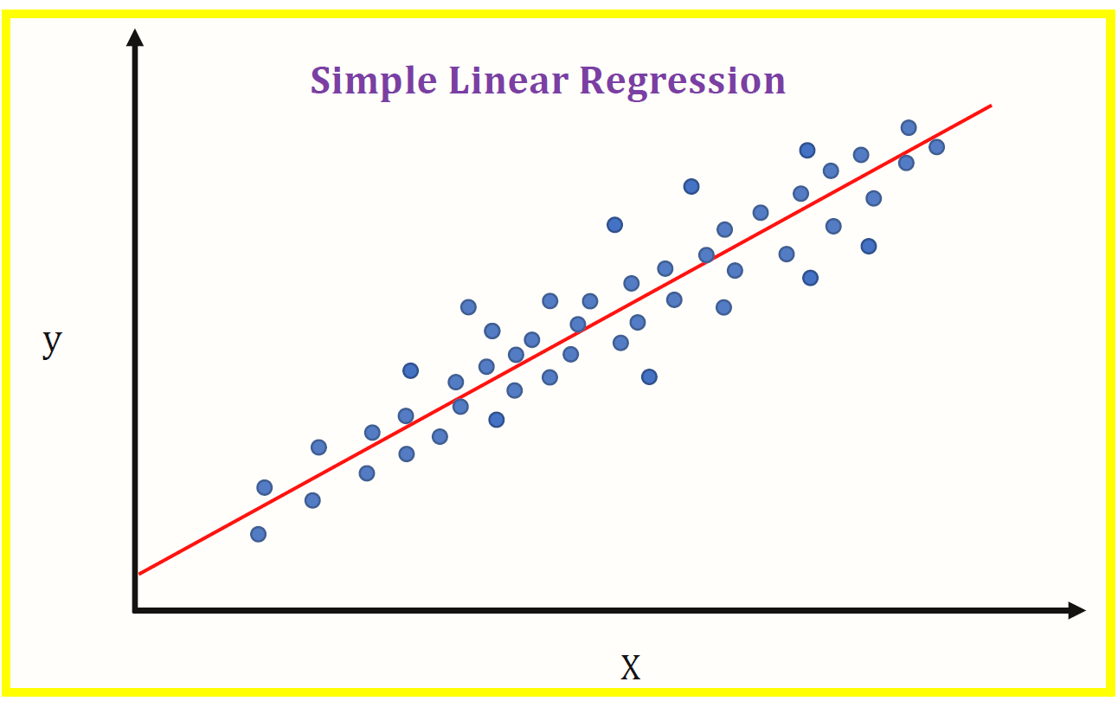
4
7. Dicussion,Conclusion and Refrences

Slide 5
The best Fit Line equation provides a straight line that represents the relationship between the dependent and independent variables.
The slope of the line indicates how much the dependent variable changes for a unit change in the independent variable.
4
7. Dicussion,Conclusion and Refrences

Slide 6
Example:
X (input) is the work experience and Y (output) is the salary of a person. The regression line is the best-fit line for our model.
4
7. Dicussion,Conclusion and Refrences

Slide 7
Why linear Regression?
Predicting numerical values based on input features
Identifying correlations between variables
Understanding the impact of different factors on a particular outcome
4
7. Dicussion,Conclusion and Refrences

Slide 8
Import LinearRegression
Create an instance of model
Train, test split
Finding the accuracy
We don’t have tunable parameters in lr like we had in knn because the model already works by finding the line of best fit.
7. Dicussion,Conclusion and Refrences

Slide 9
Logistic Regression:
It is a classification model that predict the probability that an unseen data point fall in which category.
Probability values are between 0 and 1.
Thats why its called regression model
7. Dicussion,Conclusion and Refrences

Slide 10
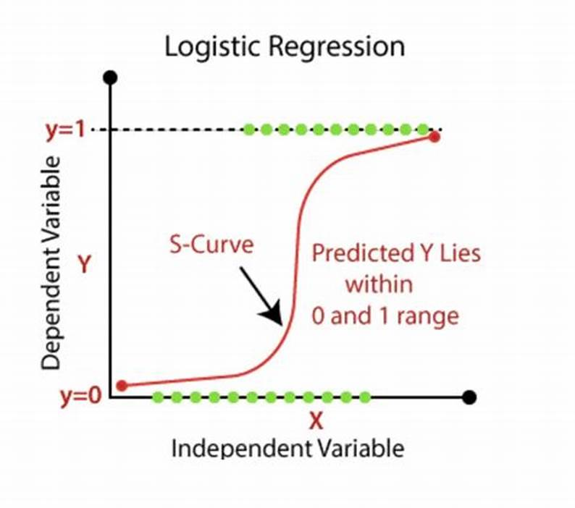
7. Dicussion,Conclusion and Refrences

Slide 11
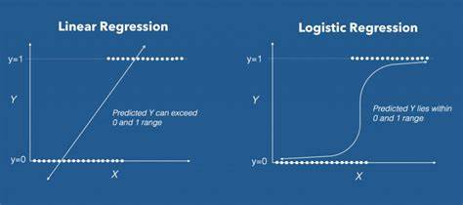
7. Dicussion,Conclusion and Refrences

Slide 12
Predict student is pass or Fail?
Either 0 or 1?
Probabilty lies between 0 and 1, continuos numbers(0.789, 0.999, etc)
7. Dicussion,Conclusion and Refrences

Slide 13
Support Vector Machines:
Find the hyperplane that best separates the classes in a dataset.
For binary classification, the hyperplane maximizes the margin (distance between the hyperplane and the closest data points from both classes, called support vectors)
7. Dicussion,Conclusion and Refrences

Slide 14
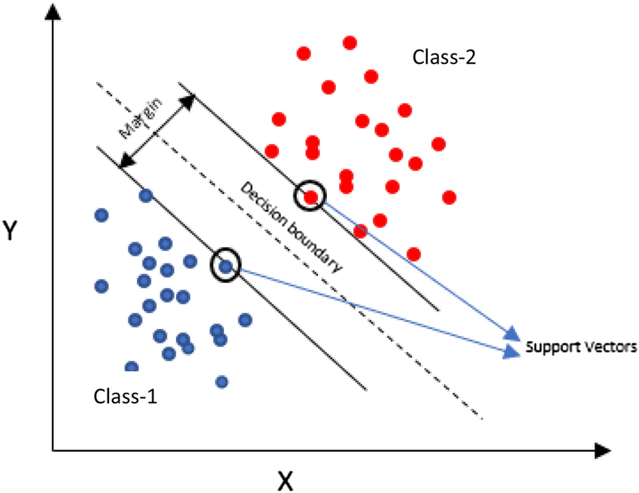
7. Dicussion,Conclusion and Refrences

Slide 15
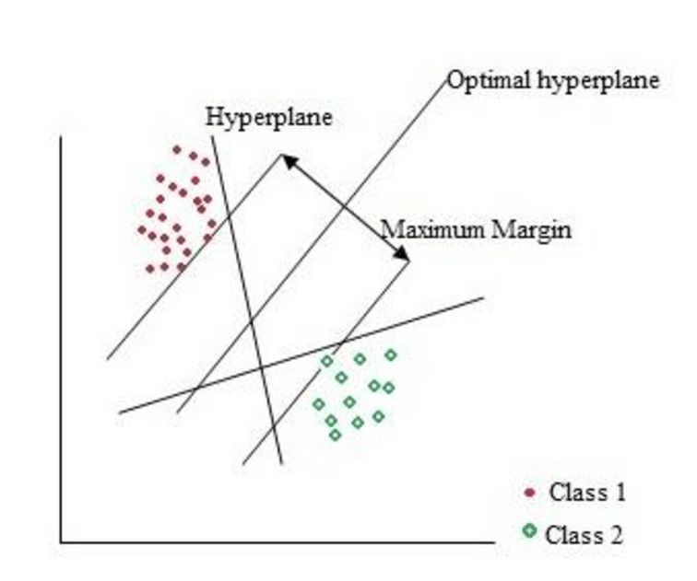
7. Dicussion,Conclusion and Refrences

Slide 16
Maximum Likelihood Estimation (MLE) is a statistical method used to estimate the parameters of a model by finding the values that maximize the likelihood of the observed data.
7. Dicussion,Conclusion and Refrences

Slide 17
Maximum Likelihood Estimation (MLE)
building a spam filter for emails. The model needs to determine probabilities for words like "discount" or "offer" appearing in spam emails.
MLE helps the model estimate these probabilities based on the training data (e.g., how often "discount" appeared in emails labeled as spam).
7. Dicussion,Conclusion and Refrences

Slide 18
Maximum Likelihood Estimation (MLE)
Machine learning models like logistic regression or neural networks often involve estimating parameters (e.g., weights, biases) to fit the data.
MLE helps find the parameters that make the observed data most likely under the model
7. Dicussion,Conclusion and Refrences

